Slide 1
Kinetic Molecular Theory of Gases
B.Sc Chem (H) 1st Semester
Physical Chemistry
Dr. Sayantani Chatterjee
Assistant Professor
Vijaygarh Jyotish Ray College
8,2 Jadavpur Central Rd
Bijoygarh, Jadavpur
Kolkata-700032

Slide 2
Learning Objectives
1. Assumptions of Kinetic theory of gases.
2. Derivations of Kinetic Gas Equation
3. Derivations and practical implications of Boyle’s Law, Charles Law, Avogadro’s Law and Graham’s Law of Diffusion

Slide 3
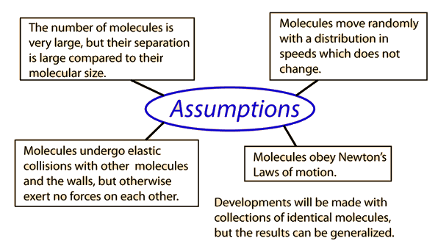
Kinetic Theory of Gases- Assumptions

Slide 4
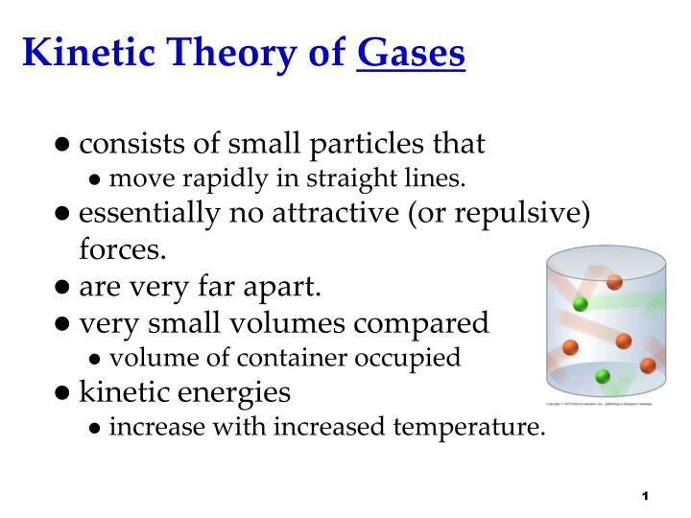
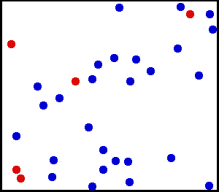

Slide 5
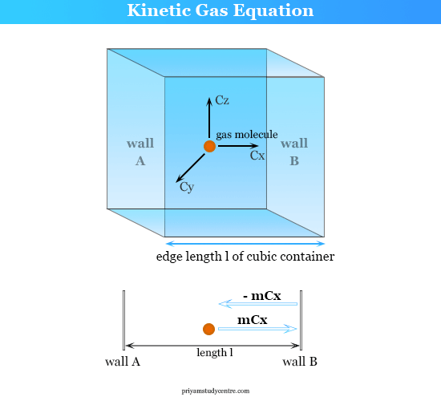
Derivation of Kinetic Gas Equation

Slide 6
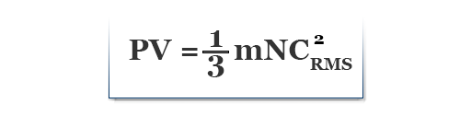
Derivation of Kinetic Gas Equation
Let us take a cubic container with edge length l containing N molecules of gas of molecular mass = m, and RMS speed = C_{RMS} at temperature T and pressure P. Among these molecules, N₁ has velocity C₁, N₂ has velocity C₂, N₃ has velocity C₃, and so on. Let us concentrate our calculation on unit or single-molecule among N₁ that has resultant velocity C₁ and the component velocities are C_{x}, C_{y}, C_{z}. Therefore, C₁² = C_{x}² + C_{y}² + C_{z}^{2.}
If the molecule will collide walls A and B of the container with the component velocity C_{x} and other opposite faces by C_{y} and C_{z}. Therefore, the change of momentum along X-direction for a single collision, = m C_{x} – (- m C_{x}) = 2 m C_{x}. A rate change of momentum along X, Y, and Z-direction is 2mC_{x}²/l, 2mC_{y}²/l, and 2mC_{z}²/l. Total rate change of momentum for the molecule given on the picture, 2m(C_{x}² + C_{y}² + C_{z}²)/l = 2mC₁²/l.
For N₁ molecules, change of momentum = 2mN₁C₁²/l. If we consider all the molecules of the gas present in this cubic container, total change of momentum = 2mNC_{RMS}²/l, where C_{RMS} = root means square velocity.
According to Newton’s second law of motion, the rate of change of momentum due to wall collision is equal to the force developed within the gases. Therefore, P × 6l² = (2mNC_{RMS}²)/l
or, P × 3l³ = mNC_{RMS}²
or, P × l³ = mNC_{RMS}²/3

Slide 7
Boyle’s Law
Boyle's law states that, at constant temperature, the pressure P of a gas varies inversely with its volume V, or PV = k, where k is a constant.

Slide 8
Derivation of Boyle’s law from Kinetic Gas Equation
From kinetic gas equation,
PV=1/3 mnC²
Or, PV=2/3 X 1/2 (MC²)
We know, 1/2 (MC²) = Kinetic Energy of the gas
PV=2KT/3
PV= Constant
2/3 and K both are constant, and T is constant in case of Boyle’s law.
Here, PV= Constant—this is nothing but Boyle’s Law

Slide 9
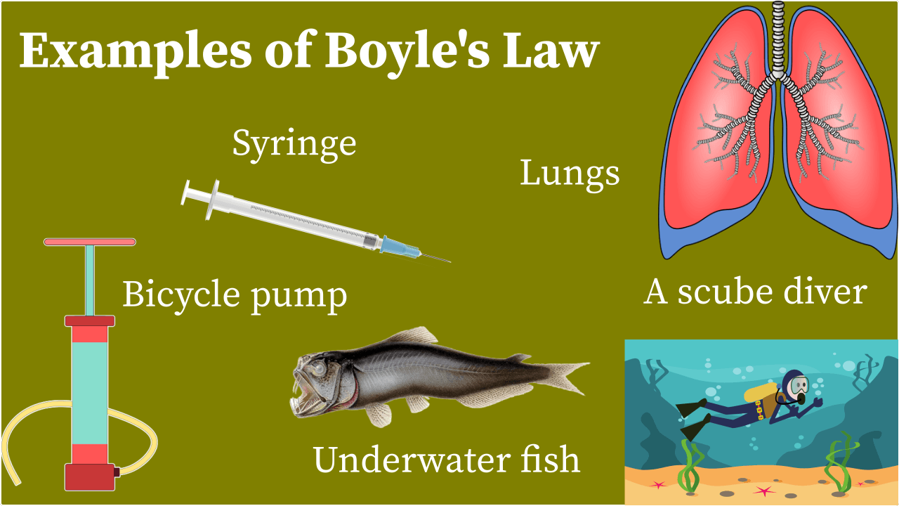

Slide 10
Charles’ Law
Charles's law states that the volume occupied by a fixed amount of gas at constant pressure is directly proportional to its absolute temperature.

Slide 11
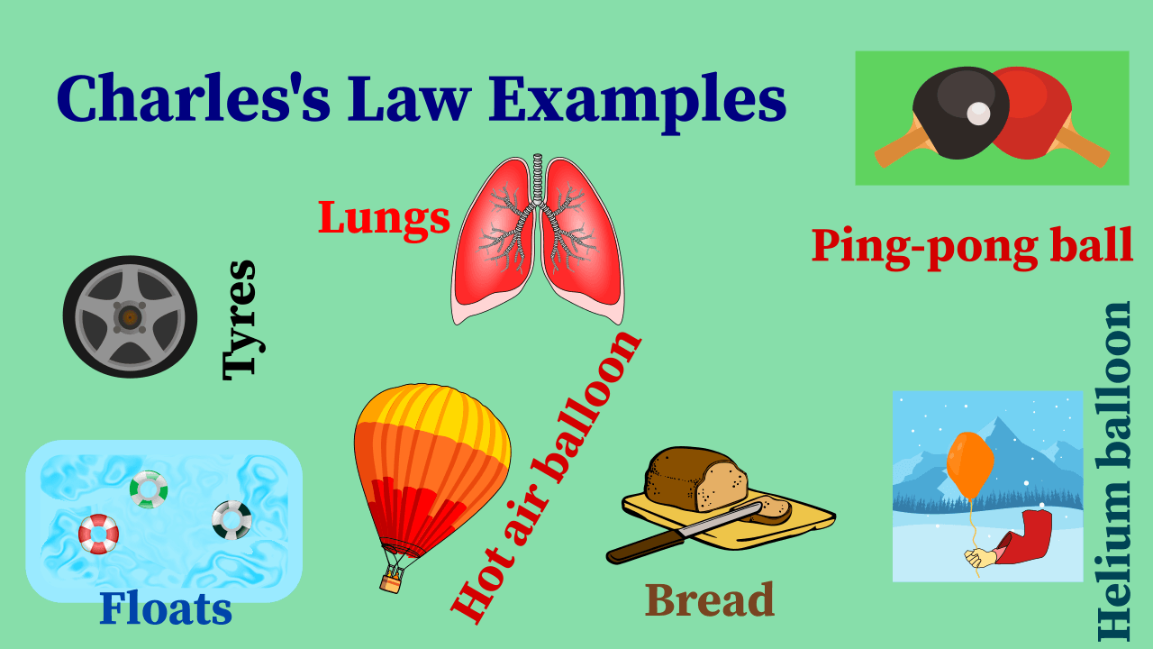

Slide 12
Derivation of Charles law from Kinetic Gas Equation
From kinetic gas equation,
PV=1/3 mnC²
Or, PV=2/3 X 1/2 (MC²)
We know, 1/2 (MC²) = Kinetic Energy of the gas
PV=2KT/3
V/T=2K/3P
2/3 and K both are constant, hence P is kept constant,
V/T= Constant—this is nothing but Charles Law

Slide 13
Graham’s Diffusion law
Graham's law states that the rate of diffusion or of effusion of a gas is inversely proportional to the square root of its molecular weight as well as mass densities.

Slide 14
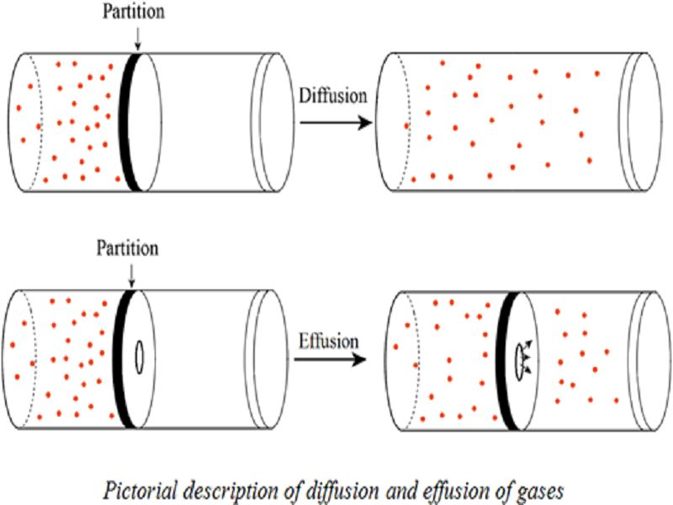
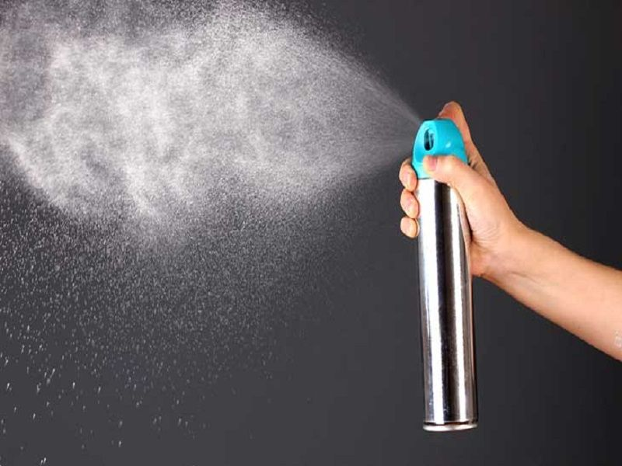
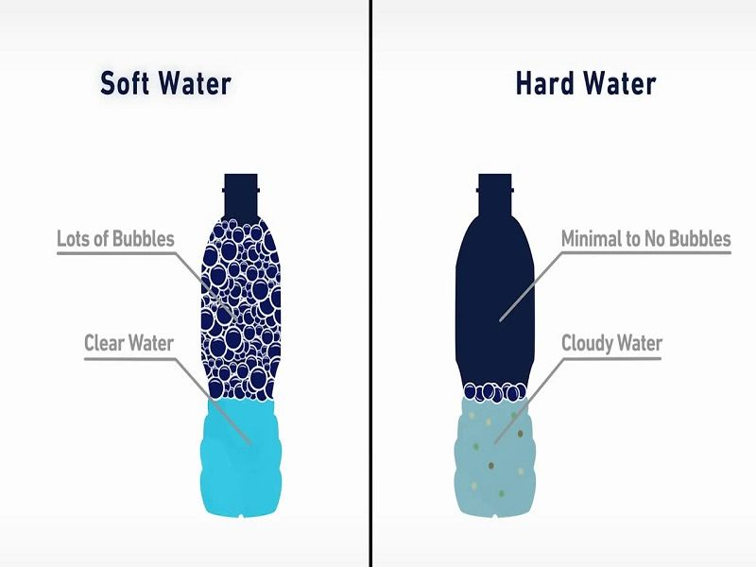

Practical Applications of Graham’ Diffusion Law

Slide 15
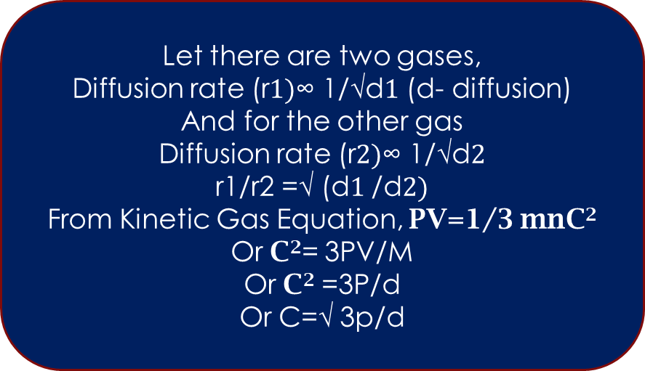
Derivation of Graham’s diffusion law from Kinetic gas equation
For the two gases -
C1/C2=√d2/d1
Or r1/r2=√d2/d1
Let there are two gases,
Diffusion rate (r$1)$∞ 1/√d$1$ (d- diffusion)
And for the other gas
Diffusion rate (r$2)$∞ 1/√d$2$
r1/r2 =√ (d$1$/d$2)$
From Kinetic Gas Equation, PV=1/3 mnC²
Or C²= 3PV/M
Or C² =3P/d
Or C=√ 3p/d
Graham’sDiffusion law states that the rate of diffusion or of effusion of a gas is inversely proportional to the square root of its molecular weight as well as mass densities.

Slide 16
Practical Implications of Graham's law of diffusion
It helps to separate gases having different densities.
It helps in the separation of isotopes of certain elements.
It helps to determine the molecular weight of an unknown gas by using the rates of diffusion/effusion.

Slide 17
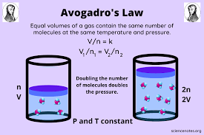
Avogadro’s law
According to this law, at same temp and pressure if two gases are having same volume then they will possesses same number of molecules.

Slide 18
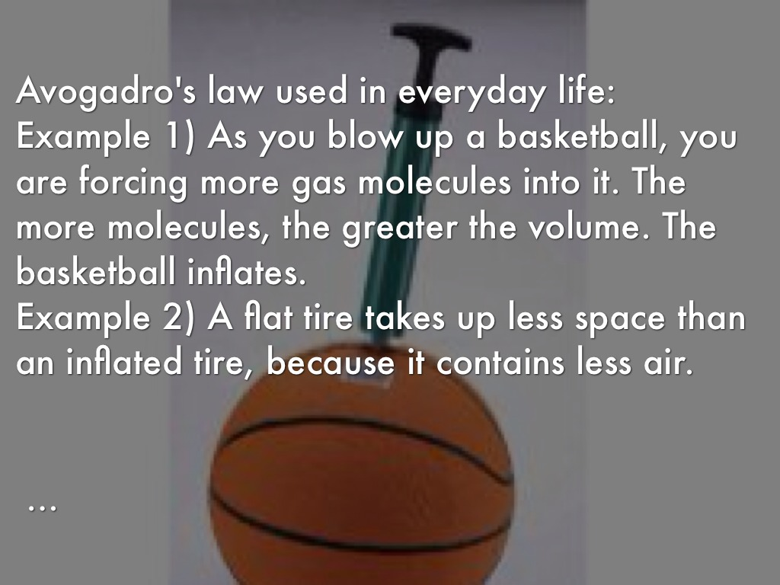
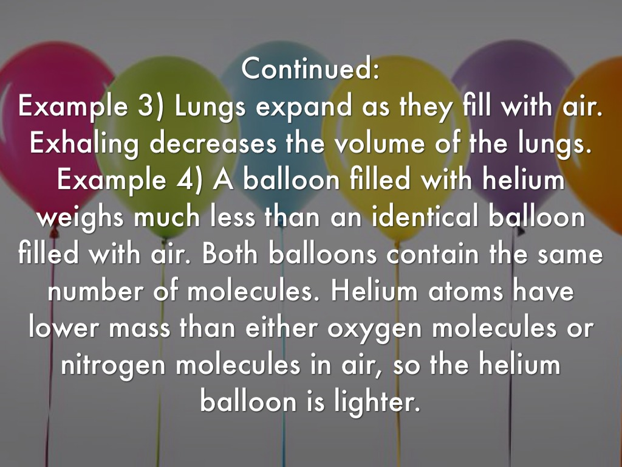
Practical Implication of Avogadro’s Law

Slide 19
Derivation of Avogadro’s Law from Kinetic Gas Equation

Slide 20
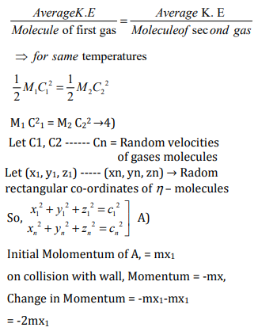
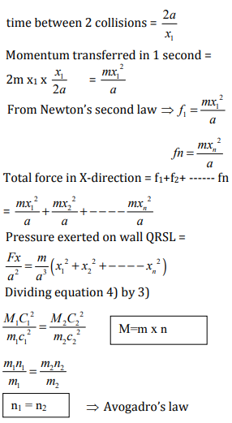
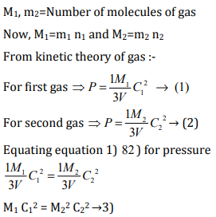
Avogadro’s law states that equal volumes of all gases under identical conditions of temperature and pressure, contain the same number of molecules.Consider two gas having equal volumes ‘V’ at temperature ‘T’ and pressure ‘P’.
Let M1=Mass of first gas , M2=Mass of second gas , C1=C2=r.m.s velocity of gas molecules of two gases m1/ m2 = Mass of each molecule of gas.

Slide 21
Next Day’s topic
Deviation of gas from ideal behavior
Van der waals equation in detail.

Slide 22


