Slide 1
Statistical Thermodynamics
B.Sc Chem (H) 5 th Semester
Physical Chemistry
Dr. Sayantani Chatterjee
Assistant Professor
Vijaygarh Jyotish Ray College
8,2 Jadavpur Central Rd
Bijoygarh, Jadavpur
Kolkata-700032

Slide 2
What is Statistical Thermodynamics?
Statistical World deals with microscopic world while Classical world deals with macroscopic world

Slide 3
Difference between Classical and Statistical Thermodynamics

Slide 4
Distribution of Particles in energy levels according to statistical thermodynamics
Maxwell Boltzmann Distribution
Fermi Direct Distribution
Bose Einstein Distribution

Slide 5
Maxwell Boltzmann Distribution
Assumptions-
Particles are distinguishable.
No restrictions are there i.e. any one of the particles can occupy any of the energy level.
The distribution is independent of internal structure of the particles.

Slide 6
Bose Einstein Distribution
Assumptions-
Bose Einstein Distribution
Assumptions--
Particles are indistinguishable.
No restrictions are there i.e. any one of the particles can occupy any of the energy level.
Only those particles follow this distribution whose nuclear spins are in integral multiple e.g. 1,2,3. These particles are called Boson particles.
Wave functions of boson particles are symmetric e.g. hydrogen, helium, nitogen etc.

Slide 7
Fermi Direct Distribution
Assumptions--
Particles are indistinguishable.
Restrictions are there e.g. only one particle can occupy any of the energy level.
Only those particles follow this distribution whose nuclear spins are in half integral multiple e.g. 1/2,3/2,7/2. These particles are called Fermions.
Wave functions of these particles are antisymmetric.

Slide 8
Ensembles
Large collection of identical units i.e, molecules , particles and atoms

Slide 9
Ensembles
Probability densities in phase space cannot be computed by considering only a single system at a single instant in time. Such a system will be in some random microstate, but what we need is the statistics of such microstates. This problem was solved by Gibbs, who considered ensembles that consist of a very large number of identical systems in possibly different microstates. The microstates for a system with M molecules with f degrees of freedom each are points in 2fMdimensional phase space. If we have information on the probability density assigned to such points, we can use probability theory to compute thermodynamical state function.

Slide 10
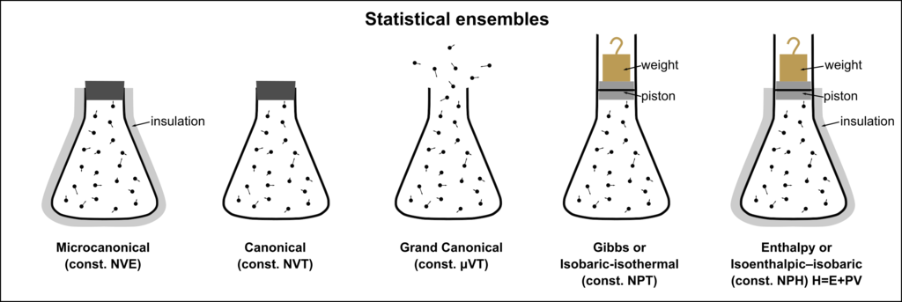
Classification of Ensembles

Slide 11
Discussions of problems on fermions and Bosons

Slide 12
Thermodynamic properties in terms of Partition Functions
Internal Energy
Pressure
Enthalpy
Entropy
Heat Capacity

Slide 13
Partition Function
Properties
Concept

Slide 14
Numerical Problems

Slide 15


